Slide 1
Support Vector Machines

Slide 2
Support Vector Machines – What are they?
A Support Vector Machine (SVM) is a supervised machine learning algorithm.
It can be employed for both classification and regression purposes.
SVMs are more commonly used in classification problems

Slide 3
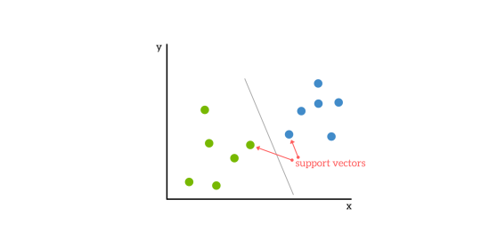
Support Vector Machines – What are they?
SVMs are based on the idea of finding a hyperplane that best divides a dataset into two classes, as shown in the image below.

Slide 4
Support Vectors
Support vectors are the data points nearest to the hyperplane.
If support vectors are removed, would alter the position of the dividing hyperplane.
Because of this, they can be considered the critical elements of a data set.

Slide 5
What is a hyperplane?
As a simple example, for a classification task with only two features (like the image above), you can think of a hyperplane as a line that linearly separates and classifies a set of data.
Intuitively, the farther from the hyperplane our data points lie, the more confident we are that they have been correctly classified. We therefore want our data points to be as far away from the hyperplane as possible, while still being on the correct side of it.
So when new testing data is added, whatever side of the hyperplane it lands will decide the class that we assign to it.

Slide 6
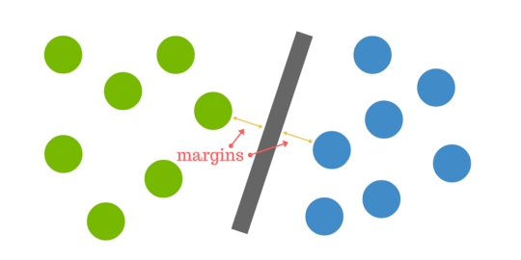
How do we find the right hyperplane?
Or, in other words, how do we best segregate the two classes within the data?
The distance between the hyperplane and the nearest data point from either set is known as the margin. The goal is to choose a hyperplane with the greatest possible margin between the hyperplane and any point within the training set, giving a greater chance of new data being classified correctly.

Slide 7
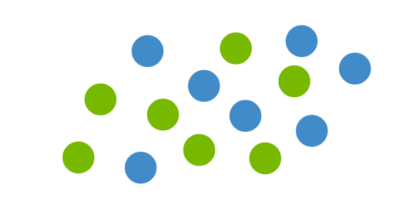
But what happens when there is no clear hyperplane?
This is where it can get tricky. Data is rarely ever as clean as our simple example above. A dataset will often look more like the jumbled balls below which represent a linearly non separable dataset.

Slide 8
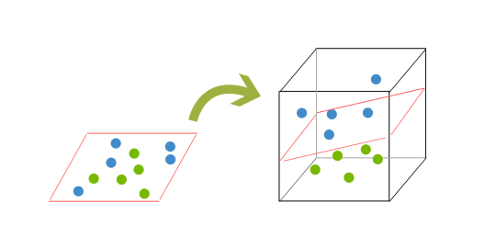
And what to do when there is no clear hyperplane?
In order to classify a dataset like the one in previous slide it’s necessary to move away from a 2d view of the data to a 3d view. Explaining this is easiest with another simplified example. Imagine that our two sets of colored balls above are sitting on a sheet and this sheet is lifted suddenly, launching the balls into the air. While the balls are up in the air, you use the sheet to separate them. This ‘lifting’ of the balls represents the mapping of data into a higher dimension. This is known as kernelling or kernel trick.
Because we are now in three dimensions, our hyperplane can no longer be a line. It must now be a plane as shown in the example above. The idea is that the data will continue to be mapped into higher and higher dimensions until a hyperplane can be formed to segregate it.

Slide 9
How to implement SVM in Python?
import numpy as np
from sklearn import svm, datasets
iris = datasets.load_iris()
X = iris.data[:, :2] # we only take the first two features.
y = iris.target
svc = svm.SVC(kernel='linear').fit(X, y)
pred_target=svc.predict([X[100]])
print(pred_target)
actual=y[100]
print (actual)

Slide 10
SVC : kernel parameter
kernel: Wee have various options available with kernel like, “linear”, “rbf”,”poly” and others (default value is “rbf”). Here “rbf” and “poly” are useful for non-linear hyper-plane. Let’s look at the example, where we’ve used linear kernel on two feature of iris data set to classify their class.

Slide 11
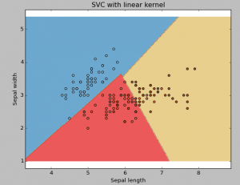
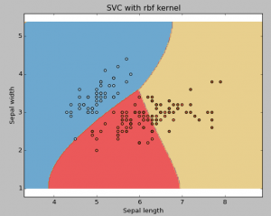
Example: Have linear kernel
Example: Have rbf kernel

